Slide 1
Accurate parallel summation of floating-point numbers
Final internship presentation
Uri Verner
Summer 2014
Notes:
Devtech, manager, mentor

Slide 2
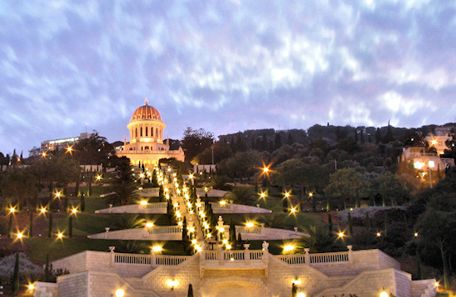

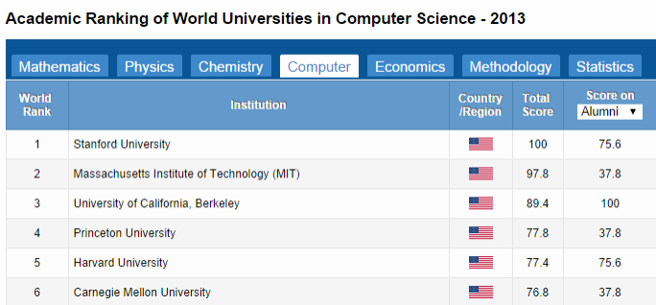
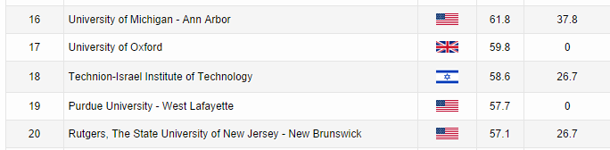
Personal info
Uri Verner
PhD student in Computer Science at
Technion in Haifa, Israel
Research
Main focus: Processing data streams with real-time
latency constraints on heterogeneous systems
Teaching
Parallel programming, GPGPU, OS, Industrial projects
 uri.verner@gmail.com
\\\\\\\\\\\\
http://www.shanghairanking.com/

Slide 3
1 | Who needs accurate summation?
2 | IEEE-754 floating-point standard
3 | Error-free summation of FP
4 | Parallel summation on GPUs
5 | Performance
Overview

Slide 4

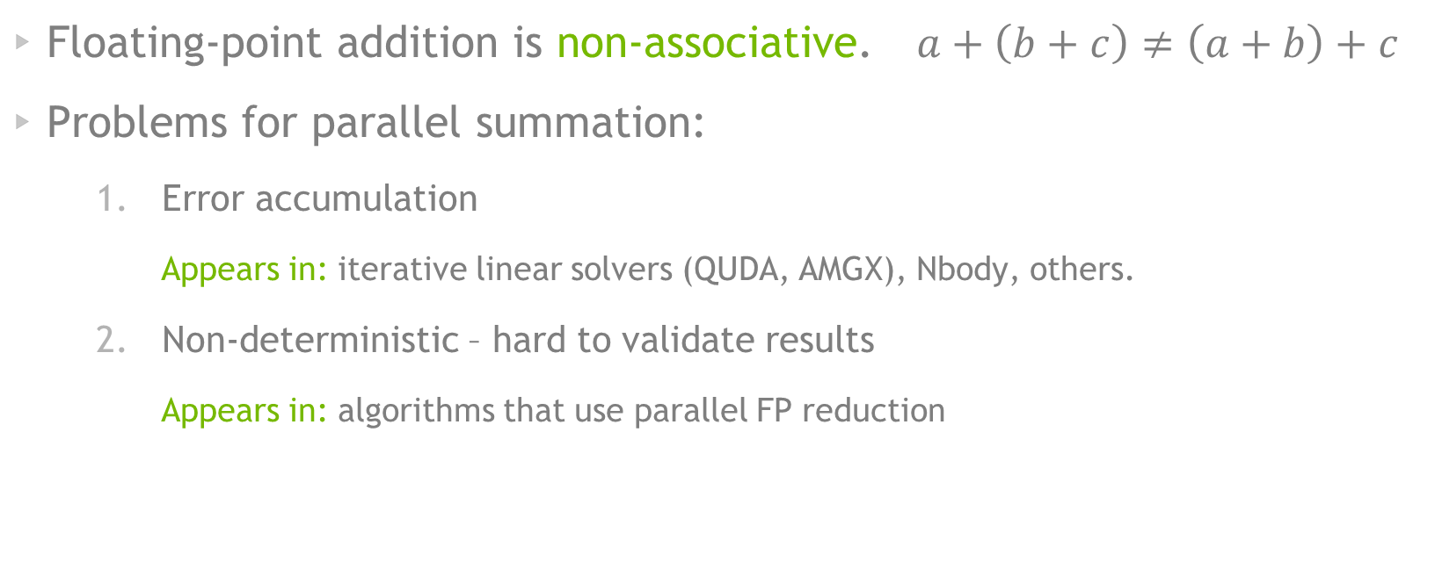
Parallel summation of FP
Floating-point addition is non-associative. $a+\left(b+c\right)≠\left(a+b\right)+c$
Problems for parallel summation:
Error accumulation
Appears in: iterative linear solvers (QUDA, AMGX), Nbody, others.
Non-deterministic – hard to validate results
Appears in: algorithms that use parallel FP reduction

Slide 5
Parallel summation of FP
“With the exact inner product the recurrence relations that Krylov solvers will not break down, increasing their stability and reducing the number of iterations to reach target residual tolerance.”, Mike Clark (QUDA)
“In conjugate gradients (CG), the theory dictates that for an NxN linear system, CG will exactly solve the system in N iterations. In practice due to the finite-precision errors (…) it can take more than N iterations to solve the system (to some target tolerance). With an exact dot product, we should recover convergence in N iterations.”, Mike Clark (QUDA)
“An example solver that can show horrible convergence is BiCGstab … in some of the complex-valued finite-difference operators in LQCD it appears to show chaotic convergence at finite precision, but it has recently been shown that this chaos is damped as the precision improves.”, Mike again
Floating-point addition is non-associative. $a+\left(b+c\right)≠\left(a+b\right)+c$
Problems for parallel summation:
Error accumulation
Appears in: iterative linear solvers (QUDA, AMGX), Nbody, others.
Non-deterministic – hard to validate results
Appears in: algorithms that use parallel FP reduction

Slide 6

IEEE-754 Floating-point standard
32-bit float
64-bit double
EXP range: (float) -126 – 127
(double) -1022 – 1023
Special cases:
+/-NaN, +/-Inf, +/-0, subnormals
S |  | EXP |  | SIGNIFICANT DIGITS
1 |  | 8 |  | 23bit
1 |  | 11 |  | 52bit
1 | 00000000000000000001
+ 1 | 00000000000000000000
1 | 00000000000000000000 | 1

Slide 7
Two-Sum ALGORITHM (KNUTH)
Computes the sum and round-off error
[s,r] = TwoSum(a,b)
s <- a+b
z <- s-b
r <- (b-(s-z)) + (a-z)
Example with four digits
1001000 <- 111100 + 1111 (72 <- 60+15)
111000 <- 1001000 – 1111 (56)
0011.00 <- (-0001.000)+(0100.0) (+3)
6 FP operations

Slide 8
Fast Two-Sum (DEkKER)
Requires EXP(a) $≥$ EXP(b)
[s,r] = FastTwoSum(a,b)
s <- a+b
z <- s-a
r <- b-z
Example with four digits
1001000 <- 111100 + 1111 (72 <- 60+15)
1100 <- 1001000 – 111100 (12)
0011.00 <- (1111 - 1100) (+3)
3 FP operations
For arbitrary a,b requires an extra if(|a|<|b|)

Slide 9
Error-free parallel summation

Slide 10
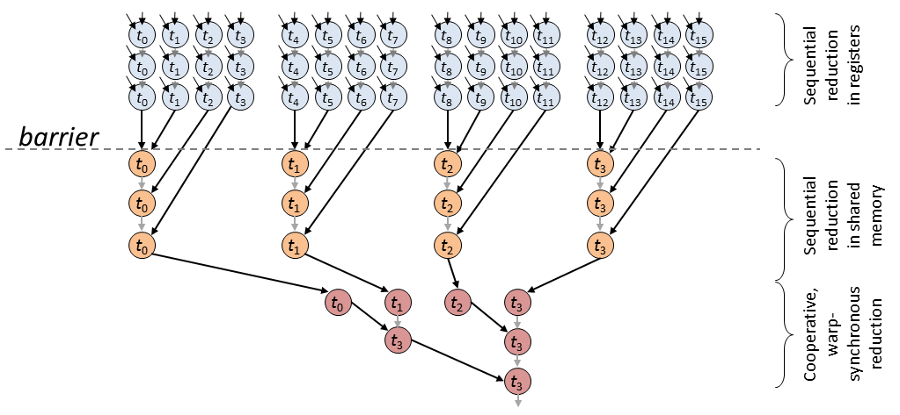
CUB: Parallel primitives in cuda
Parallel sum: reduction with Sum() operator
Instead, use TwoSum() to compute an error-free sum.

Slide 11
Two-sum in Parallel reduction
Problem 1
The output of TwoSum is two FPs, instead of one!
+
=
(x1,x2)=2Sum(s1,s2)
(y1,y2)=2Sum(r1,r2)
x2=x2+y1
(x1,x2)=fast(x1,x2)
x2=x2+y2
(s3,r3)=fast(x1,x2)
Solution
Convert each item x into a pair (x,0.0)
Define a sum operation for (s3,r3) = (s1,r1) + (s2,r2)

Slide 12
Two-sum in Parallel reduction
Problem 2
A pair (s,r) may overflow due to limited dynamic range
1 | 00000000000000000001
+1 | 00000000000000000001 | 000000000000000000000
+1 | 00000000000000000001 | 000000000000000000000000000000000000000000
1 | 00000000000000000001 | 1 | 00000000000000000001 | 100000000000000000001
SUM AND REMAINDER
OVERFLOW

Slide 13

Two-sum in Parallel reduction
Problem 2
SUM
REMAINDER
1 | 00000000000000000001
1 | 00000000000000000000 | 10000000000000000000
+1 | 00000000000000000000
1 | 10000000000000000000 | 10000000000000000000
+1 | 00000000000000000000
1 | 00000000000000000000 | 0 | 10000000000000000000
+1 | 00000000000000000000
1 | 10000000000000000000 | 1000000000000000000 | 0
+1 | 00000000000000000001
No problem, still many unused bits left
Many numbers can be added to (s,r) if they are close
Notes:
PUT 1 in last bit of last word, close the gap, purple zero goes right

Slide 14
DividE the exponent range into bins
Add each number to the corresponding bin
+ | 0 |  | 1023 |  | 010101010101010101
1023 | \ (2048/8)= 3
compute bin id
add
s | r
0
s | r
1
s | r
2
s | r
3
s | r
4
s | r
5
s | r
6
s | r
7
Number of EXP values: 2048 (double)

Slide 15
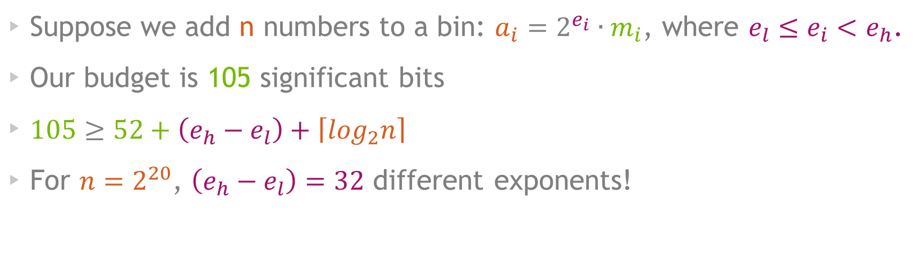

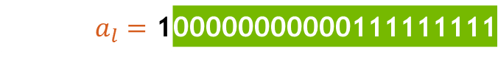
How many exponent values per bin
1. | 00000000000000000001 | 1 | 000000000000000000000
105 bits
Suppose we add n numbers to a bin: $a_{i}=2^{e_{i}}∙m_{i}$, where $e_{l}≤e_{i}<e_{h}$.
Our budget is 105 significant bits
$105≥52+\left(e_{h}−e_{l}\right)+\left\lceil \log_{2}n\right\rceil$
For $n=2^{20}$, $\left(e_{h}−e_{l}\right)=32$ different exponents!
$a_{l}=$ 1 | 00000000000111111111
$a_{h}=$1 | 11111111111111111111 | 000000000
$$e_{h}−e_{l}$$

Slide 16
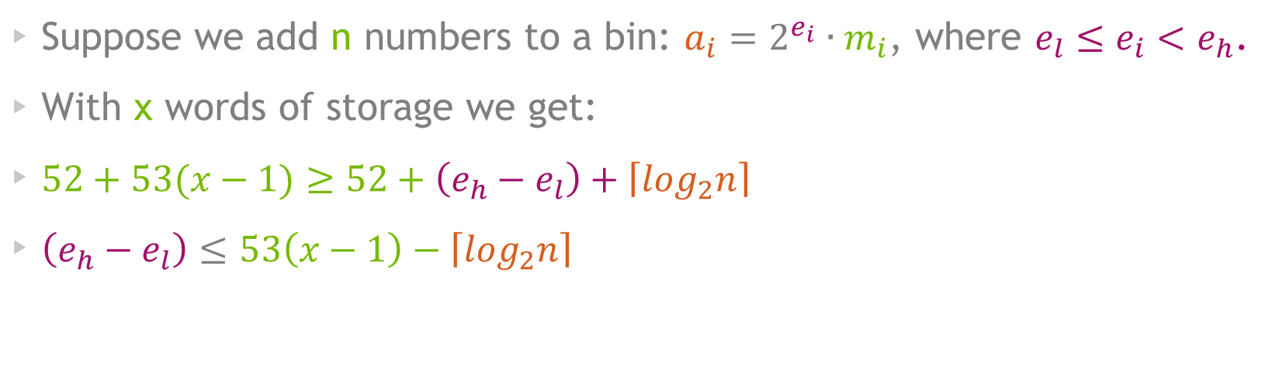
Expanding the remainder
1. | 00000000000000000001 | 1 | 000000000000000000000 | 1 | 000000000000000000000
158 bits
Suppose we add n numbers to a bin: $a_{i}=2^{e_{i}}∙m_{i}$, where $e_{l}≤e_{i}<e_{h}$.
With x words of storage we get:
$52+53(x−1)≥52+\left(e_{h}−e_{l}\right)+\left\lceil \log_{2}n\right\rceil$
$\left(e_{h}−e_{l}\right)≤53\left(x−1\right)−\left\lceil \log_{2}n\right\rceil$

Slide 17
Error-free summation algorithm for GPUs

Slide 18
Sort-reduce Algorithm
Each thread-block processes a part of the input numbers
Each thread-block has a set of bins in shared memory
Read input tile
Radix-sort by bin
Reduce-by-key sum to bins in registers
Add results to running sums in shared mem
---
Finally, sum all the bins from all the thread-blocks

Slide 19
EXAMPLE
| $2^{−80}$ | $2^{0}$ | $2^{31}$ | $2^{60}$ | $2^{50}$ | $2^{−90}$ | $2^{1}$ | $2^{0}$ |
EXPONENT=11bit
radix-sort
binidx=6bit | bin=5bit
| $2^{−80}$ | $2^{−90}$ | $2^{31}$ | $2^{0}$ | $2^{1}$ | $2^{0}$ | $2^{60}$ | $2^{50}$ |
reduce-by-key
update bins
s | r
0
s | r
1
s | r
s | r
s | r
…
s | r
s | r
s | r
63

Slide 20
EXAMPLE
| $2^{−80}$ | $2^{0}$ | $2^{31}$ | $2^{60}$ | $2^{50}$ | $2^{−90}$ | $2^{1}$ | $2^{0}$ |
wider bins less sort bits but more computations
EXPONENT=11bit
idx=5bit | bin=6bit
| $2^{−80}$ | $2^{−90}$ | $2^{31}$ | $2^{0}$ | $2^{1}$ | $2^{0}$ | $2^{60}$ | $2^{50}$ |
s | r | rr
0
s | r | rr
1
s | r | rr
s | r | rr
s | r | rr
…
s | r | rr
s | r | rr
s | r | rr
31

Slide 21
ANOTHER ALGORITHM TO TRY
Do not sort and reduce the input
Each thread atomically adds to bin in shared memory
Use multiple sets of bins to divide the load

Slide 22
Alternative method
“Superaccumulator”, Collange et al.
Use fixed-precision arithmetic on very large variables
“Full-Speed Deterministic Bit-Accurate Parallel Floating-Point Summation on Multi- and Many-Core Architectures”, Sylvain Collange, David Defour, Stef Graillat, and Roman Iakymchuk
S |  | EXP |  | SIGNIFICANT DIGITS
 | SIGNIFICANT DIGITS
atomic-add with carry propagation
FIXED-PRECISION. SPANS THE ENTIRE RANGE OF DOUBLE-PRECISION NUMBERS

Slide 23
Method comparison
Qualitative
 | sort & scan | atomic with bins | Superaccumulator
Computations/item | High | Low | Medium-High
Compute type | FP64 | FP64 | INT64
smem atomics use | None | High+ | Medium-High
Performance variability | Low | High+ (atomics) | High (atomics)
“Adaptivity” to new GPU architectures | Good. Based on parallel primitives | Performance limited by smem atomics | Requires tuning to new architectures

Slide 24
SUMMATION of the per-block bins
Step 1: For each bin id, sum all the bins with this id
+
0
1
…
63
s | r
s | r
s | r
s | r
s | r
s | r
s | r
s | r
Block 0
s | r
s | r
s | r
s | r
s | r
s | r
s | r
s | r
Block 1
s | r
s | r
s | r
s | r
s | r
s | r
s | r
s | r
…
s | r
s | r
s | r
s | r
s | r
s | r
s | r
s | r
s | r | rr
s | r | rr
s | r | rr
s | r | rr
s | r | rr
s | r | rr
s | r | rr
s | r | rr
0
1
…
63
If >1M values total in one bin, we need an extra word
Notes:
If we have < 1M words, we will need only 2 words in the output

Slide 25
SUMMATION of the per-block bins
Step 2: serial sum from low to high
s | r | rr
s | r | rr
s | r | rr
s | r | rr
s | r | rr
s | r | rr
s | r | rr
s | r | rr
 |  |  |  |  |  |  |  |  |  |  |  |  |  |  |  |  |  |  |  |  | s | r | rr
 |  |  |  |  |  |  |  |  |  |  |  |  |  |  |  |  |  |  |  | s | r | rr
 |  |  |  |  |  |  |  |  |  |  |  |  |  |  |  |  |  |  | s | r | rr
 |  |  |  |  |  |  |  |  |  |  |  |  |  |  |  |  |  | s | r | rr
…
s | r | rr
0
1
2
3
…
63
Final result rounded to the nearest double
Notes:
Round 3 words to 2, and then add to the next bin.
Animation

Slide 26
Performance

Slide 27
Performance comparison
Kernel throughput on a K40c GPU
(peak)

Slide 28
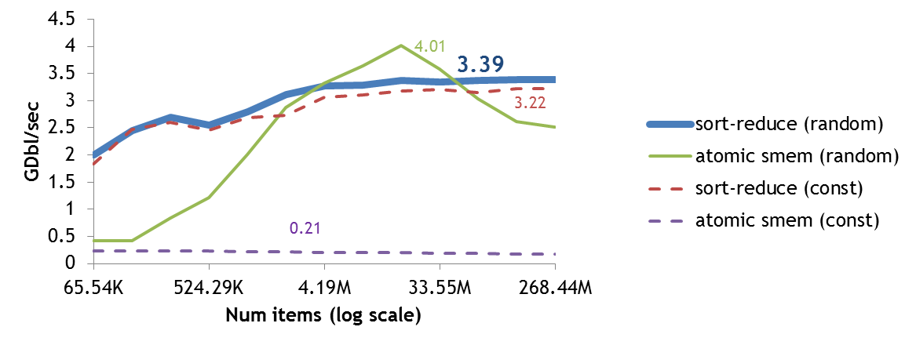
Performance as function of input size

Slide 29
Performance as function of input size
stable performance for sort-reduce

Slide 30
Performance as function of input size
Up to 18% higher performance for atomic-smem in some cases

Slide 31
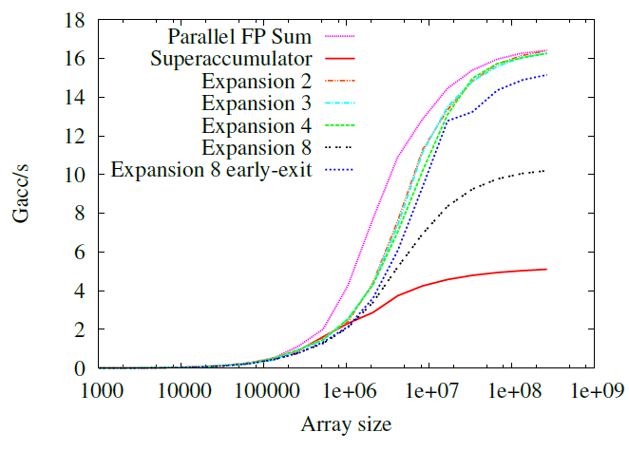
Superaccumulator Performance
K20c, 67M items
“Full-Speed Deterministic Bit-Accurate Parallel Floating-Point Summation on Multi- and Many-Core Architectures”, Sylvain Collange, David Defour, Stef Graillat, and Roman Iakymchuk

Slide 32
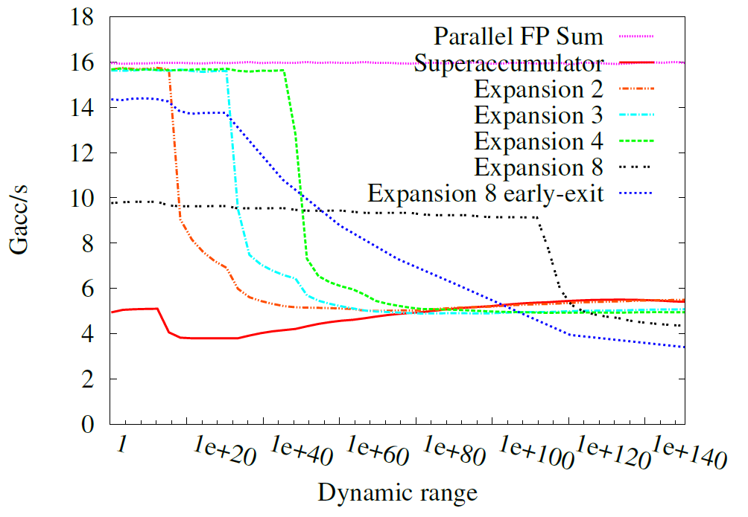
Superaccumulator Performance
K20c, 67M items
“Full-Speed Deterministic Bit-Accurate Parallel Floating-Point Summation on Multi- and Many-Core Architectures”, Sylvain Collange, David Defour, Stef Graillat, and Roman Iakymchuk

Slide 33
IMPROVEMENT Directions
Less computations
Allow remainder to overlap sum
Avoid atomics bottleneck on smem
In-register bins across a group of threads instead of in smem
Sort less if some exponent ranges are not used
Reduce execution dependency

Slide 34
Thank you!

